Slide 1
Training Neural Nets with Back Propagation to Control Xpilot Agents
Researcher: Skylar Levey, 2019
Advisor: Gary Parker

Slide 2
What is Xpilot/Xpilot-AI
Open-source two-dimensional space combat simulator.
Simple controls - thrust, turn and shoot.
Xpilot-AI is a platform that was developed to test AI learning systems.
Allows researchers access to information about the environment
such as position, enemy position, speed, heading, along with others.
This information is updated every frame of gameplay to allow actual real time control of an agent.

Slide 3
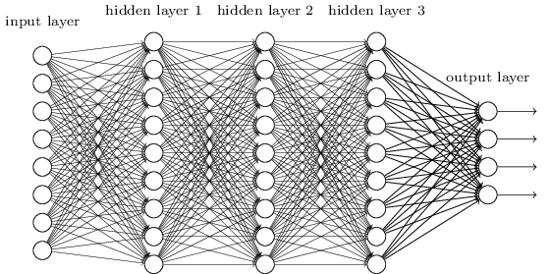
Introduction
My goal was to test the effectiveness of an Xpilot agent that is controlled by a neural net whose weights are learned through the use of back propagation.
There have been agents controlled by genetic algorithms, neural nets taught by genetic algorithms (like on the last slide), fuzzy logic systems, and rule based systems.
However, a neural net taught with back propagation had never been tested. This is due to the fact that back propagation requires something to observe, which is not always easy to find.

Slide 4
How do Neural Nets Work
.7
.5
Neural nets are essentially just complex pattern recognizers.
They are made up of several rows of nodes with weights
connecting them.
An input is fed into one side, computations are done, and
then an output is spit out of the other side.
The hidden layers allow for complex inputs to be subtly
distinguished from other similar inputs.
.2
.4
.5
.25
.5
1.2
.5
2
.25
.5
.5
.33
.4
.8
.3

Slide 5
How does Backpropagation work?
1? 0?
.3
.7
.5
.5
For each node, calculate how much of an impact it had on the error.
With this error make a small adjustments to the weights so that next time the neural net comes across the same input it’s output is a little more correct.
.2
.25
.4
.5
.5
1.2
.5
2
.25
.5
.5
.33
.4
.8
.3

Slide 6
What I did
During each frame:
Observe the bot’s position and what it did
Feed these input into my neural net to see what it would decide to do if it was in the same situation.
Compare my agent’s output to the what the observed agent did in that frame and propagate the error back through the NN to train it.
Repeat, a lot of times (a few million).

Slide 7
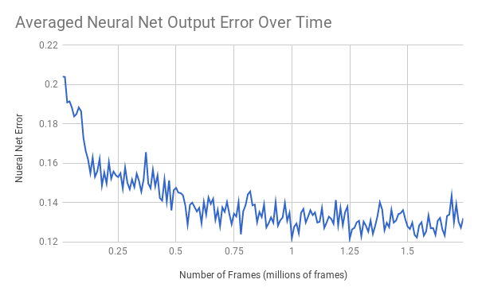
Results (Last Semester)
Error formula = ∑ .5*(output - desired)²

Slide 8
This Semester
Update on the shifted goal of the project (strictly performance instead of error)
Removed shooting
Some problems I ran into
(I coded the neural net)

Slide 9
Results (This semester)
Show Demo

Slide 10
Discussion/Analysis
-Talk about significance of strictly NN controller

Slide 11
Further Research
Get the agent to shoot
Maybe a project that actually optimizes inputs with a GA

Slide 12
Thanks!
Questions?

Slide 13
Further Research
Further research could include delving deeper into the variables of the learning with backpropagation, answering questions like:
Is there an optimal time to observe/can you over train?
What structure is best for the neural net?
Can you have too many inputs?
Is a deep neural net better for controlling an xpilot agent?
Of these I am personally most curious about the last question. Adding more hidden layers to a neural net increases the complexity it can process and learn to categorize. Having worked with xpilot, the game is more complex than I originally thought, and adding another hidden layer or two may yield better results .

Slide 14
Discussion/Analysis
The main takeaway is that it worked, but it was far from smooth sailing.
One problem I encountered was that even though the neural net learned to mimic the observed bot very well, sometimes it was not as good at playing the game.
Specifically with trusting, it was difficult to find the correct threshold value for when to thrust as if it was too high my agent would never thrust, but then if it was lowered it would then constantly be thrusting and would crash.
Along with this my agent would also be backing into a wall and would react a frame or two late and would try to thrust after it had already crashed

